Slide 1
PSY330
One-Way Repeated-Measures ANOVA with SPSS
Trudy Kuo, Ph.D.

Slide 2
How should the data be organized in SPSS?
Data organization in SPSS must be consistent with the statistical test
Golden rule: Each row represents one subject (or any entity measured)
One-Way ANOVA (between-subjects factor)
Subject | IV level | DV data
1 | 1 | 23
2 | 1 | 34
3 | 1 | 14
4 | 1 | 25
5 | 2 | 34
6 | 2 | 55
7 | 2 | 44
8 | 2 | 35
9 | 3 | 24
10 | 3 | 64
11 | 3 | 12
12 | 3 | 23
One-Way ANOVA (within-subjects factor)
Subject | DV data/IV level 1 | DV data/IV level 2 | DV data/IV level 3
1 | 23 | 14 | 43
2 | 34 | 25 | 25
3 | 14 | 43 | 54
4 | 25 | 25 | 34
5 | 34 | 54 | 55
6 | 55 | 34 | 44
7 | 44 | 53 | 35
8 | 35 | 13 | 25
9 | 24 | 42 | 23
10 | 64 | 31 | 34
11 | 12 | 24 | 14
12 | 23 | 34 | 31

Slide 3
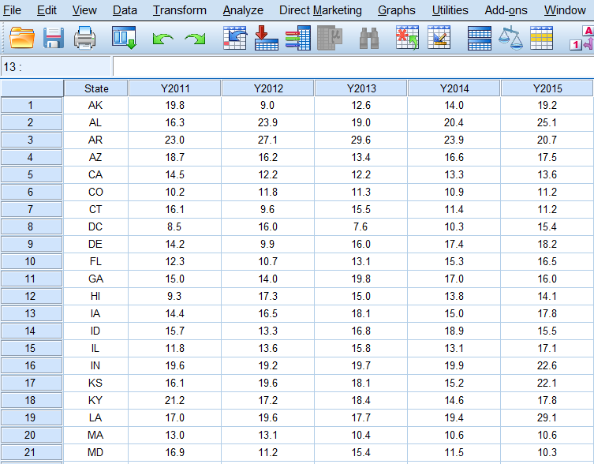
Demo data set: Obesity % by state from 2011 to 2015

Slide 4
Research question and hypotheses
Research question:
Did obesity rate change significantly across the five years from 2011 to 2015?
Did obesity rate (DV) change depending on the year (IV)?
Null hypothesis:
Obesity rate did not change across the five years from 2011 to 2015.
μ2011 = μ2012 = μ2013 = μ2014 = μ2015
Alternative hypothesis:
Obesity rate changed across the five years from 2011 to 2015.
Statistical test:
One-way repeated-measures ANOVA
Because each state provides data repeatedly every year from 2011 to 2015.
Note that the “subject” does not have to be a person!

Slide 5

SPSS: Setting up the ANOVA to run
Analyze - General Linear Model –
Repeated Measures
Enter Factor Name, specify number of levels, click “Add”
Enter DV for Measure Name, click “Add”
Click “Define”

Slide 6


Specify which column is which level:
Select all the levels of the factor, click the “→” to move them into Within-Subject Variables
(Hold control or command key to select multiple levels at once)
Select follow-up tests between levels:
In “Contrasts”, highlight the within-subjects factor, select Contrast to “Repeated”, then click “Change”
(This will contrast each pair of levels from first to last: 2011 vs 2012, 2012 vs 2013… etc.)

Slide 7


If you click on “Post Hoc”, there will be no choices available because post hoc comparisons are only for between-subjects factors with 3 or more levels.
(We don’t have a between-subjects factor here.)
Specify “Options”
Select “Descriptive statistics” and “Estimates of effect size”. There is no need to select Homogeneity tests because we don’t have any between-subjects factor.

Slide 8
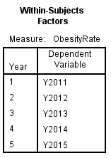
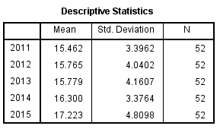
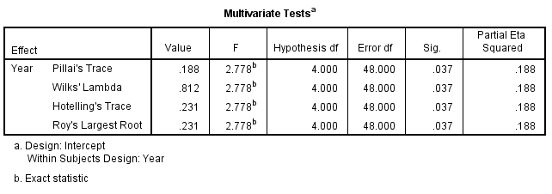
SPSS: Interpreting the output
This table shows the within-subjects factor to be “year”; The “Dependent Variable” should be ObesityRate in Y2011, ObesityRate in Y2012… etc.
This table shows the mean ObesityRate across all the subjects (states) in each year.
This table can be ignored in our current interpretation of the result.
It shows an alternative way to analyze the five ObesityRates as separate dependent variables, making it a multivariate ANOVA (MANOVA), which is an option if the sphericity assumption is not met.

Slide 9
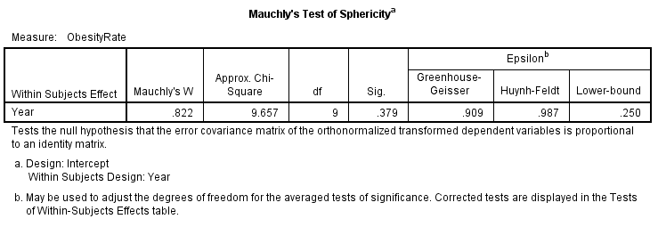
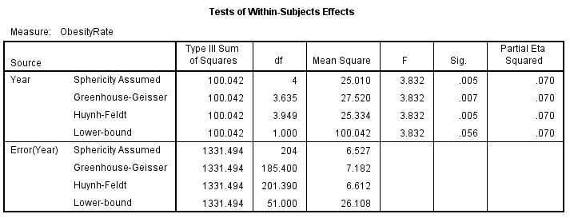
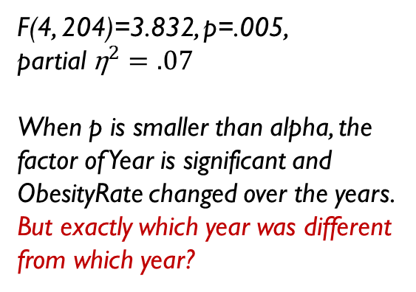
The null hypothesis represents the assumption of Sphericity.
The p is .379, larger than the alpha of .05, so the null hypothesis has a high probability of being true. We can assume sphericity in the data.
F(4, 204)=3.832, p=.005,
partial ${\text{η}}^{2}=.07$
When p is smaller than alpha, the factor of Year is significant and ObesityRate changed over the years.
But exactly which year was different from which year?

Slide 10
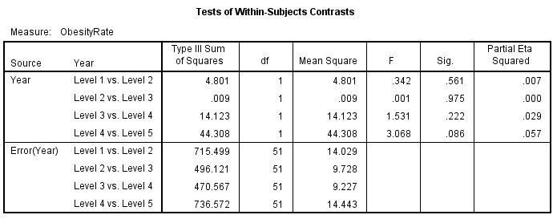
We selected “Repeated” contrasts:
Each year is only compared to the next year. None of the comparisons were significant because all the p values are larger than alpha. There was no significant difference from one year to the next, during the five years.
Different methods of contrasting the levels can serve different purposes and answer different research questions.

Slide 11
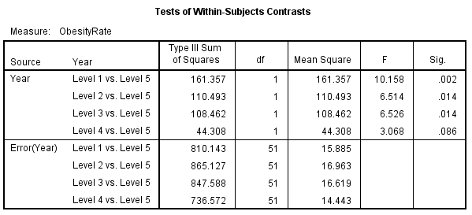
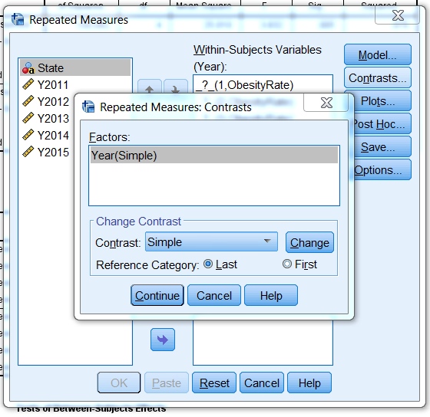
SPSS: Rerun the ANOVA with more options
A different type of contrasts:
Remember to click “Change” and specify whether the last or the first level should be compared to all other levels.
When compared to level 5 (Year 2015), all previous years were significantly different in ObesityRate while level 4 (2014) and level 5 were not significantly different.
→ There was a trend of increase from 2011 to 2015.

Slide 12
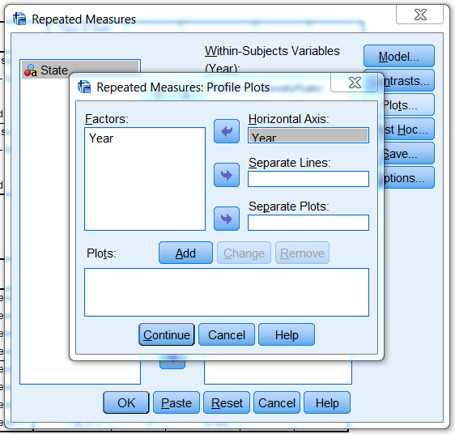
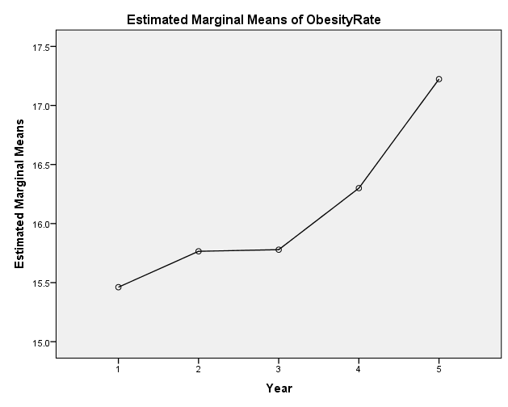
Requesting a plot (graph) to demonstrate the changes in ObesityRate from 2011 to 2015.
Move the factor to “Horizontal Axis” and then click “Add” and “Continue.”
The ObesityRate was elevating steadily throughout the period from 2011 to 2015.

Slide 13
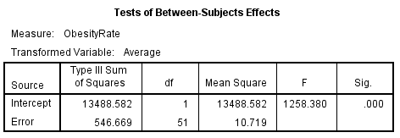
Reminder: What is the “intercept”?
In ANOVA, the test on “intercept” is checking to see if the grand mean from the sample (average of all scores) is significantly different from zero. Since we have all positive scores in this research scenario, the grand mean is of course significantly different from zero and the test result is highly significant with a huge F statistic and tiny p value.
It is not critical to our interpretation of the ANOVA result so we can leave it out in our report of the analysis.

